Slide 1
SD + DE
2023
Mobile Applications
Class 3
Daan Nijs

Slide 2
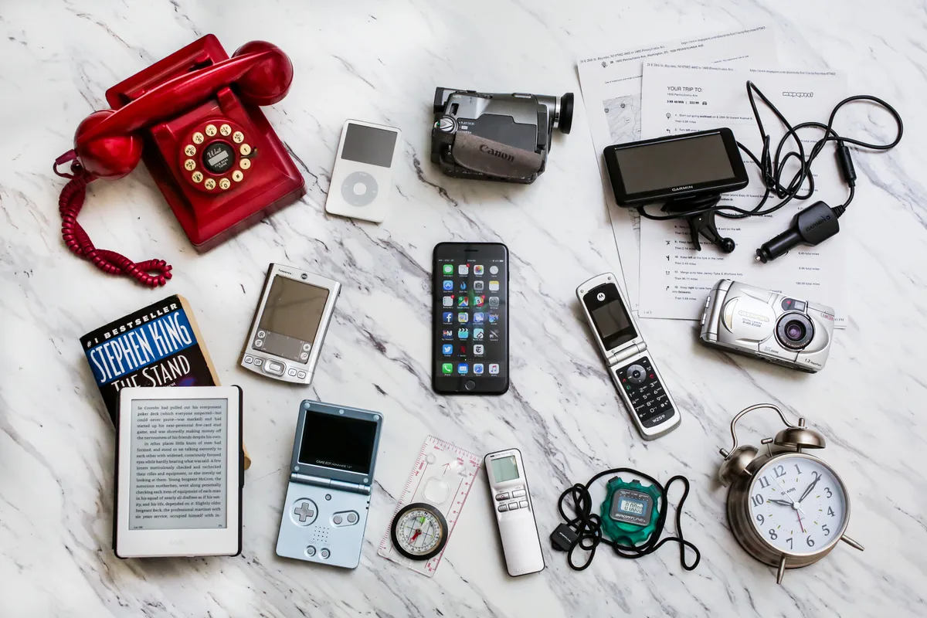
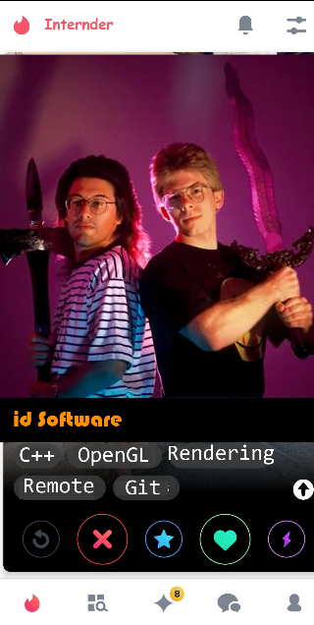
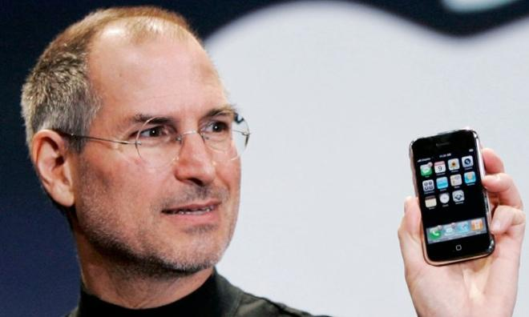
Last class
Went over the pitch (will do so again)
Looked at possibilities of mobile hardware

Slide 3
This class
Clarification about evaluation (again)
Clarification about the pitch (again, with some common pitfalls)
Look at working on device / emulator / developing locally
Look at development sequence : “Hello World” / Vertical slice / Demo / MVP

Slide 4
Course planning : context
Week 1 No class
Week 2 C1 : Introduction, design, pitch
Week 3, 4, 5 🤒
Week 6 : pitch week Monday C2: pitch information Thursday C3: --> Emulation, productivity, pitch workshop ←
Week 7 : No class
Week 8 : Unity3D, React basics and common pitfalls
Week 8+ : TBD (accessibility, presentation, game dev, requested topics….)

Slide 5
This week
Pitch week!
Thursday 8pm: deadline for feedback (I will comment on your pitch and you can resubmit)
Monday 8pm: deadline for pitch (I comment on your pitch, put you can’t resubmit)

Slide 6
Evaluation
Your pitch : 3 points
Your presentation : 3 points
Your report : evaluated as part of your defense
Your defense : 14 points

Slide 7
Evaluation : Pitch
You get points for the quality of the pitch
How well you following the given requirements of the pitch
You will not be graded on what you’re pitching, but rather how you’re pitching it

Slide 8
Evaluation : presentation
Not related to your pitch at all
Very short
Will be done in December

Slide 9
Questions?

Slide 10
Good pitch
Example uploaded to Toledo

Slide 11
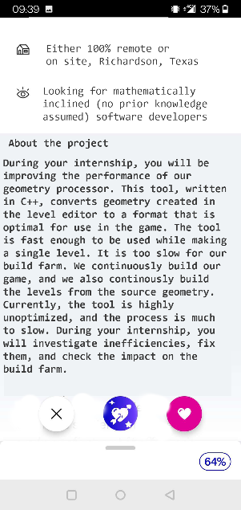
Internder
“Tinder for internships”
Images do a lot of work

Slide 12
Description
This is the problem; this is how I’m going to try and solve it.
Go into a lot of implementation detail.
“Sells” your idea (a solution).
One or two paragraphs.
Also show why your app is “intrinsically mobile”.

Slide 13
Description : pitfalls
Being too general
“We’re going to make online shopping better, more fun, more social.”
Prove with current apps that it’s not great, not fun, etc…
Better : “We’re going to make online shopping better. Current apps, like amazon, are optimized to buy immediately. In our app, all purchases are delayed by 24 hours. Your friends can see your shopping cart, and express concerns / suggest”
When you’re coding, you don’t want to have to think of what to code

Slide 14
Motivation
One or two sentences
Explains why *you* want to make the app
Sells your idea even more
“When we first investigated internships, we were demotivated by how we were supposed to sift through possible places to apply to through a dry excel with unappealing descriptions. It seems logical to make this process fun, so that people are motivated to start internships on day 1.”

Slide 15
Motivation : pitfall
“We would like to help people have a better experience”
Doesn’t feel very personal
“I have this problem in my life, my app could solve it”

Slide 16
Inspiration
Draw comparisons to existing apps (or other things, eg boardgames)
Identify problems with them
Tries to show that your idea will work

Slide 17
Inspiration : pitfall
Is not personal like motivation
Intent is to reduce risk : “These things I want to do that are done by other apps, so I know they will work”
Proves why your app solves an existing problem : “App x does a lot of things, but it doesn’t do

Slide 18
Statement of work
List all features you want in your app
Divide between need to have / nice to have
Need to have = minimal viable product* = what you need for the app to work
Need to have: ideally doable in half the time
Nice to have: ideally doable in double the time
Ideally you will implement your need to have’s, and some nice to have’s
Time estimation is hard!

Slide 19
Statement of work : Need to have
A local file with all the information (location, id, photo’s, description) of an internship.
A script to transform the existing intranet excel into this local file.
A way to swipe left and right on an internship.
A way to read a description of an internship.
A way to export a list of internships that were swiped right upon.

Slide 20
Statement of work : Nice to have
Automatically update the list of internships from intranet.
Allow photos to be uploaded and viewed.
“Compatibility score” based on a personal profile and tags on internships.
Account for distance in compatibility score.
Allow for chatting with the people offering the internships.
Allow people running the internship to swipe on students. A match is communicated to both parties.

Slide 21
Statement of work : MVP
All your need to have’s
Your mvp is not a minimal product you can put on an app store
It’s the minimal product you can defend at the exam
Account management, adding / removing friends, leaderboards are less important
Focus on your specific “niche”
In Internder, swiping, and getting internships
Mover info on MVP later

Slide 22
Tech stack
List the technologies you will use for your need to have
Technologies
Can also speculate for nice to have’s

Slide 23
Risks
A list of thigs that could go wrong
“We have never used React Native before.”
“We want to use pictures, but there are none in the database.”

Slide 24
General pitfall
The customer is me
Avoid buzzwords
Write it so I can see scope / pitfalls
Don’t do this : “Our app, TimeSaver, is a highly revolutionary, groundbreaking mobile application that uses advanced, state-of-the-art artificial intelligence algorithms to achieve the optimal allocation of your extremely precious time resources. Using geospatial data and ultra-complex predictive analytics, TimeSaver optimizes your time management through multi-factorial decision-making models of the highest caliber.”

Slide 25
What questions do you have?

Slide 26
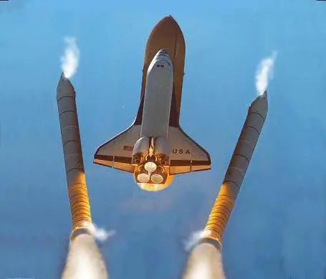
Developing in stages
Hello World
Vertical Slice / Demo
Mvp
And beyond…..

Slide 27
Hello world!
Have a single unique string shown on your device
Question : why is this useful?

Slide 28
Hello world!
Framework is installed correctly
Can make a string “hello world” visible
Can connect to my device
Can upload code on my device
Can run code on my device
Group work: we can all run this “hello world”

Slide 29
Vertical slice / demo
The smallest thing that’s usable for feedback
Hardcode data
Rough UI
No serialization / deserialization

Slide 30
Vertical Slice for Internder
3 Internships are hardcoded
No swiping, just a red button and a green button
No pictures, just descriptions
Why is this useful?

Slide 31
Vertical Slice
Improvements are visible : motivation
Feedback can be gathered quicker
In group, easier to talk about something that exists

Slide 32
Mvp
Everything that comes between the vertical slice and all the need to haves.
Make sure you’re going to have an app, before spending time on optional features.

Slide 33
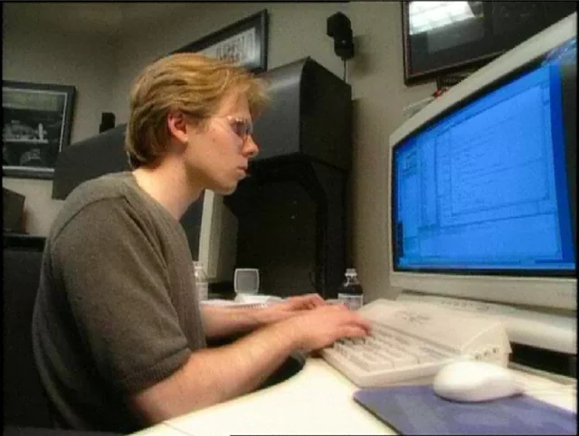
Local development is simple
Run code on the same machine you develop on
Debug on the same machine you develop on
Some challenges when deploying code (“works on my machine”)

Slide 34
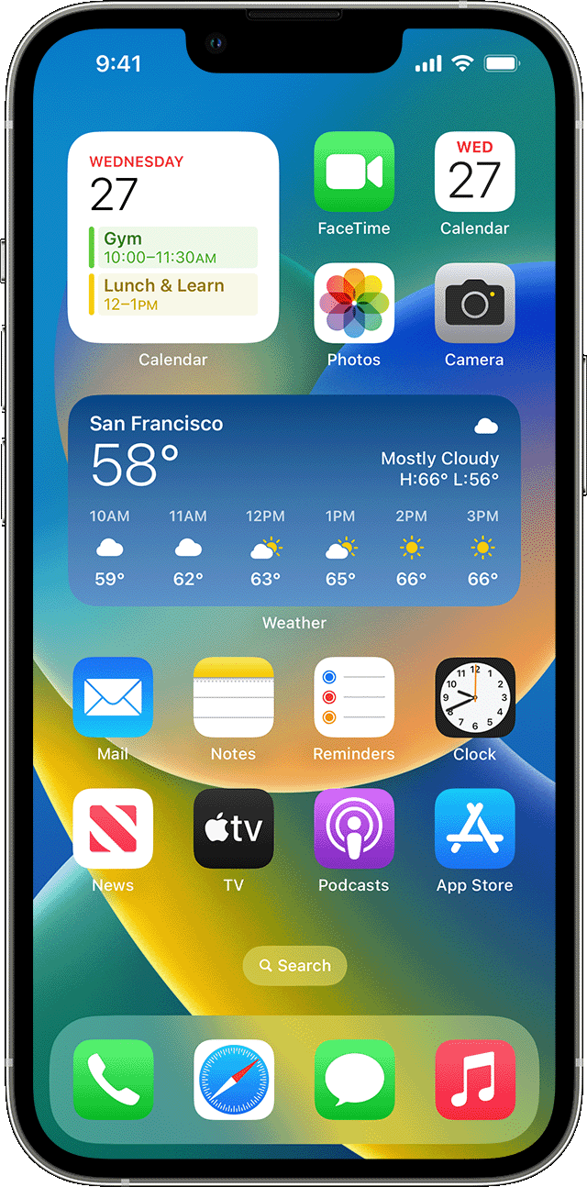
Mobile development is annoying
Application
Break points
Log output
Debug output

Slide 35
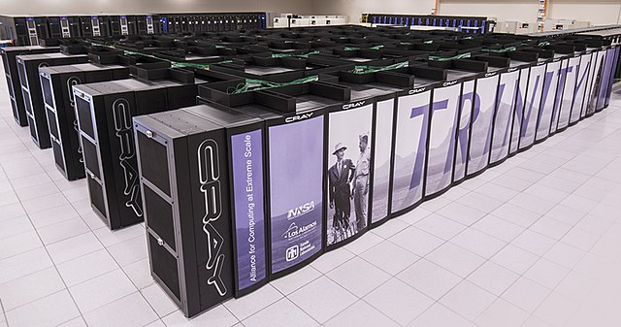
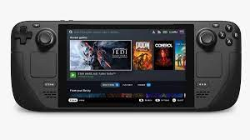
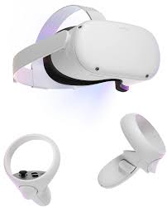
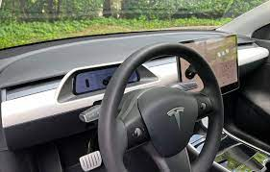
Mobile remote development is annoying
Application
Break points
Log output
Debug output

Slide 36
Iteration loop
Modify code
Compile
Upload to device
Run code
Grab device
Test Code
Goto 1
We want this as short as possible
10 minutes : can test 6 fixes an hour
10 seconds : can test 360 fixes an hour

Slide 37
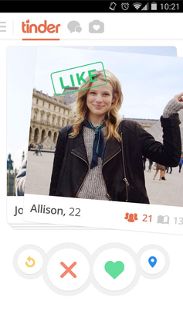
Can mitigate: run locally
Run your app on desktop
Catches 80% of bugs
No uploading
No context switch to device

Slide 38
Can mitigate: run in emulator
Run your app in an emulator
Catches 95% of bugs
‘Uploading’ is running from the same hard drive
Can use mouse, no need to context switch

Slide 39
Ideally you want all 3
Run locally for business logic
Run in emulator when doing UI work
Always run remotely (on your device) before submitting / deep testing

Slide 40
Running remotely : Android via usb
Check out Android Studio : https://developer.android.com/studio
Has command line tools included, specifically adb
Adb tells you which devices are connected
Detailed documentation: https://developer.android.com/studio/run/device

Slide 41
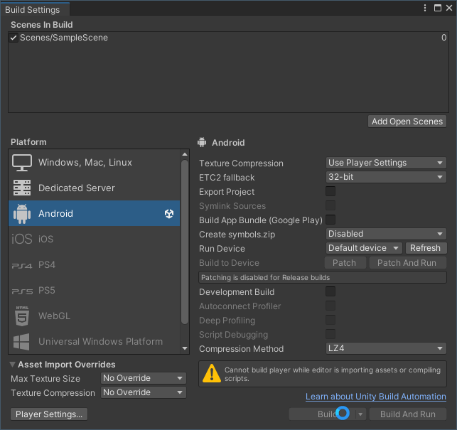
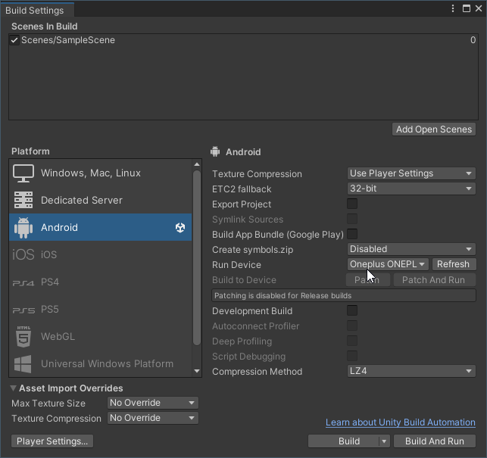
Unity : using File -> Build settings

Slide 42
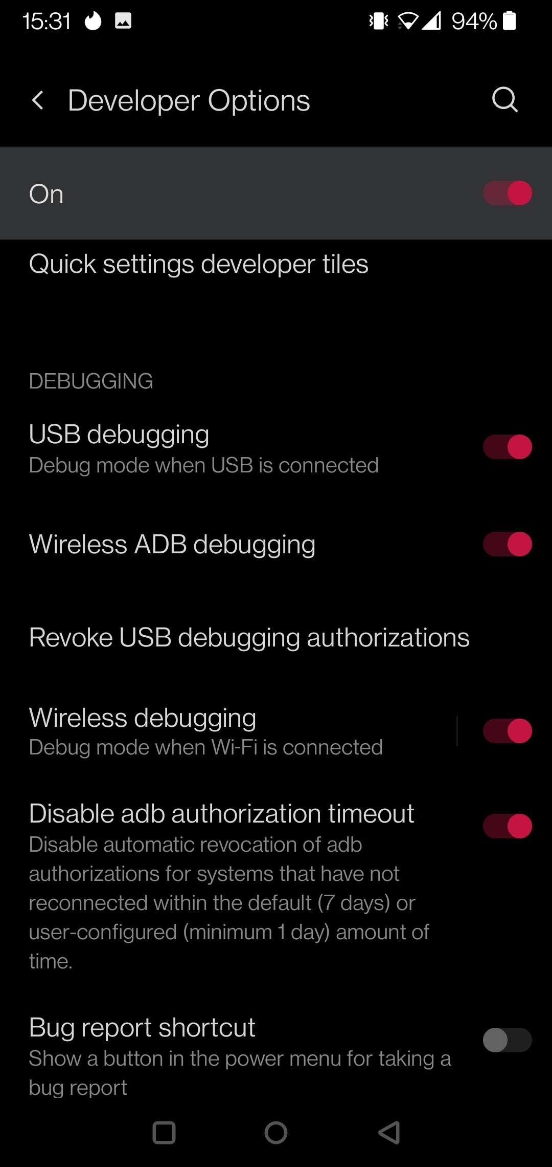
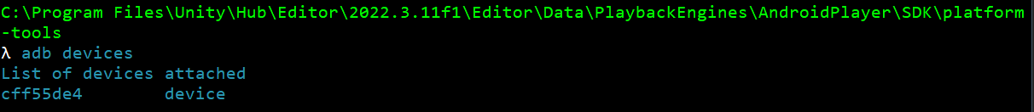
Unity : Android connection
Need to set smartphone to developer mode
“abd devices”

Slide 43
Note I’m using Unity’s adb
Unity comes with its own version of adb, can cause some conflicts

Slide 44
Unity : emulator
Check out https://docs.unity3d.com/Manual/device-simulator.html

Slide 45
React native
Check https://reactnative.dev/docs/environment-setup?guide=quickstart to run your code on device (wirelessly)
Check https://reactnative.dev/docs/environment-setup?guide=native for running on an emulator

Slide 46
Questions?

Slide 47
Lab time ☺
Made the mistake of ending class early Monday
From now on: remaining time is workshop
Work on your pitch
Work on your hello world
Raise your hand if you have any questions

